Slide 1
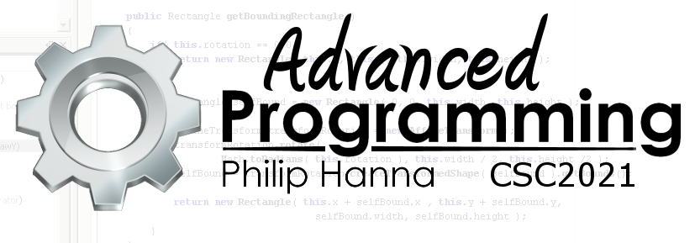
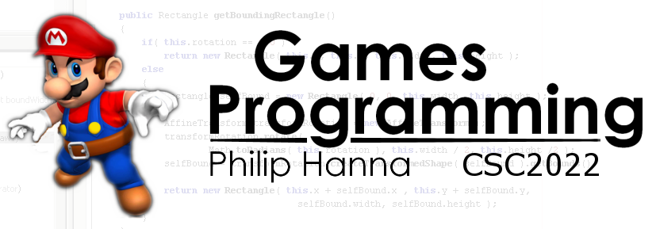
Introduction to C++
Important introductory slices of C++ for Java and C# programmers.
Part 1: Intro

Slide 2

Why C++ is awesome (in a somewhat painful way)

Slide 3
C++ was ‘born’ in the early 1980s. Whilst the language has evolved and changed to adapt to modern programming practices, it still holds to its founding principles.
Because of this, the language can be very powerful, but also it can be very unforgiving.
Notes:
C++ is a long established programming language that was ‘born’ in the early 1980s. It has evolved and changed over the years to adapt to modern programming practices.
When trying to categorise and classify C++ you should be aware of two occasionally complementary / occasionally conflictive aspects of C++ - one related to the founding rationale for C++ and the other related to the development of contemporary programming languages. These aspects contribute to the power of C++. They also contribute to difficulty of programming in C++.

Slide 4
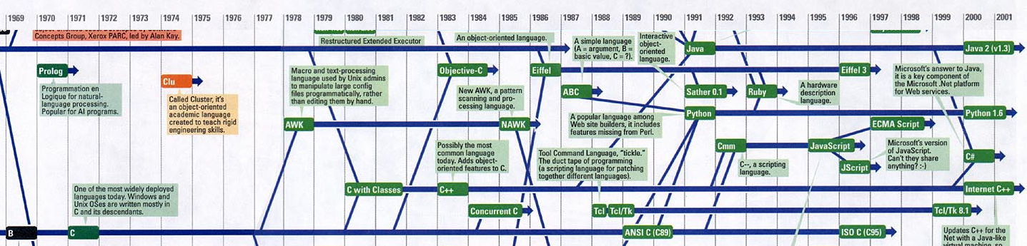
C++ was developed in the early 1980s.
C++ can be viewed as a superset of C (most C programs are also C++ programs) with added object-oriented programming capabilities.
To understand the strengths of C++ we need to consider the characteristics of the C programming language.
Notes:
C++ was developed by Bjarne Stroustrup of AT&T Bell Laboratories in the early 1980s.
The first version of C++ can be viewed as fundamentally the C programming language with object-oriented programming (classes) added on. As such, C can be viewed as a subset of C++ in that most C programs are also C++ programs.
To understand some of the strengths of C++ we need to look at the characteristics of the C programming language.
Aside: In fact, the first C++ ‘compilers’ actually took C++ code and transformed it into C code which could then be compiled using a C compiler.

Slide 5
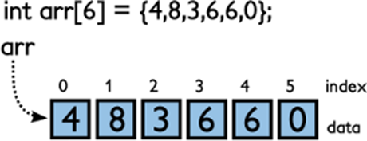
The C Programming Language
C is a (relatively) low-level language and just a step above assembly language. C remains the language of choice for low-level hardware oriented programming.
C lacks a lot of the automatic checks and safeguards of modern programming languages. This makes it fast. This also makes it dangerous; want to change the 10th element of a 6 element array? Sure, go ahead.
?
arr[9]
Notes:
The C programming language was developed by Dennis Ritchie of AT&T Bell Laboratories in the 1970s. It was used for writing and maintaining the UNIX operating system.
In today’s terms, the C language can be viewed as a low-level language and just a step above assembly language (with many C programmers being able to clearly understand how a line of C is likely to be realised in terms of assembly language or machine code). C language programs can directly manipulate the computer’s memory, etc. and C remains the language of choice when doing low-level hardware oriented programming.
This makes C an excellent choice for writing systems programs. It also means that C lacks many of the programming constructors and features that make viable the development of very large software systems.
C is a very performance oriented language – one of the way in which it achieves high performance is it (relatively) spartan lack of automatic checks and safeguards. In comparison to more modern managed languages such as C# or Java, C lets the programmer do whatever he/she wants – it simply doesn’t check if the programmer is trying to do something utterly stupid that will almost certainly crash the program. Define an array of 10 ints and try to access the 15th element, sure, no problem.

Slide 6

C++ inherits the strengths and dangers of C.
You can write relatively low-level code that can run very fast. However, you can also write C++ code that has relatively little runtime checks.
You must exercise great care when writing code (painful) and have a clear understanding of how your code will be executed (extremely useful).
Notes:
C++ inherits the strengths and dangers of C.
In C++ you can write relatively low-level code that can run very fast. As with C, one of the reasons for the speed of C++ is that it is relatively light on runtime checking (see later in terms of modern C++).
It means that you as the C++ programmer will need to be extra careful when writing code (this a pain) and have a clear understanding of how your code is executed, particularly whenever things go wrong (having this form of understanding is actually a good thing).
Warning: In comparison to C# and Java, a lot of runtime errors in C++ are reported in a comparatively vague and not-that-useful-manner.

Slide 7

The Development of C++
C++98
C++03
C++11
ANSI and later ISO work together to standardise C++ publishing an agreed standard (C++98) in 1998.
A technical correction is published in 2003. No new language features are added.
ISO publish a major revision of C++ in 2011 adding many new features and improving language consistency.
Notes:
The American National Standards Institute (ANSI) created a committee in 1990 to develop a standard for C++. The International Organization for Standardization (ISO) later joined creating a joint ANSI/ISO effort to develop the standard for C++.
An International Standard for C++ was finally adopted in 1998. This standard, (often labelled as C++98) refined existing C++ features and include additional features such as exceptions, templates, and the Standard Template Library (STL).
A second edition of the C++ standard was published in 2003. This edition tied by the first edition (typographical corrections, not new language features). As C++03 didn’t change the language features they are often referred collectively as C++98/C++03.
In August 2011 the ISO committee approved a new standard (labelled C++11). C++11 adds many new features to the language. It also removes inconsistencies and makes C++ easier to learn and use.
Aside: The ISO C++ Standard draws upon the ANSI C Standard to help ensure that C++ is (mostly) a superset of C.

Slide 8
C++11 provides features that enable the programmer to avoid ‘dangerous’ C-like features of C++.
Smart pointers instead of raw pointers.
Stack-based scope instead of heap or static global scope.
STL containers instead of raw arrays.
Auto type inference instead of explicit type names.
Robust ranged based loops instead of traditional loop termination.
Notes:
One of the drivers behind C++11 has been to develop a language that enables the programmer to better manage the dangerous C-like C++ features (such as raw pointers, null-terminated character strings, etc.)
According to the Microsoft overview of ‘Modern C++’ the language aims to emphasize (not all of these features will make sense until you’ve a better grasp of C++)
Stack-based scope instead of heap or static global scope.
Auto type inference instead of explicit type names.
Smart pointers instead of raw pointers.
std::string and std::wstring types instead of raw char[] arrays.
Standard template library (STL) containers instead of raw arrays or custom containers.
Exceptions, to report and handle error conditions.
Range-based for loops to write more robust loops that work with arrays, STL containers, and collections.
Notably, in modern C++, the programmer can avoid having to use new/delete to allocate dynamic memory because you can use smart pointers and other features instead to make code memory-safe.

Slide 9

With C++11 you can write code with much of the features and safety of C# or Java
However, in this course I want to teach you ‘old-school’ C++ Let me tell you why.
Notes:
With modern C++ it is possible to write code which much of the same language features and safety measures as for C# or Java.
However, in this introductory course to C++ I don’t want to teach you C++11 – rather I want to teach you ‘old-school’ C++.

Slide 10
C++ is a relatively ‘fast’ language. It is also a relatively ‘difficult’ language. It is fast because:
It provides the programmer with low-level programming features and lots of control over how the code is executed.
It mostly avoids runtime checks, assuming the programmer will have written correct code (this contributes to the difficulty).
It is a compiled language and has many excellent optimising compilers
Notes:
The benefit of old school C++ coding
C++ is generally classified as a relatively ‘fast’ language. It is also classified as a relatively ‘difficult’ language. Both of these statements are broadly true.
There are a couple of reasons why C++ is considered a fast language:
It provides the programmer with relatively low-level programming constructs and a lot of control over how exactly programs are executed. It is not a managed language. The programmer needs to manage memory allocation/deallocation (and hence object creation and destruction).
It mostly avoids runtime checks, assuming that the programmer will have written code that runs correctly without bugs (this is also what makes it relatively difficult)
It is a compiled language with a number of very capable compilers readily available.

Slide 11

Just because C++ lets programmers write fast programs this does not mean programmers will actually write fast programs. Disastrously inefficient programs can still be written in C++.
So how does C++ help?
It mostly avoids runtime checks, assuming the programmer will have written correct code (this contributes to the difficulty).
Because of this, most programmers find they need to deeply understand how their code will actually run.
In doing so, programmers gain a much better understanding of how to write code that is efficient.
Notes:
Just because C++ has these feature it doesn’t mean a programmer will automatically write fast code. You can write C++ code that runs atrociously slow.
Instead, because of 2 on the last slide, most C++ programmer find themselves in a position where they need to very closely understand how their code works – which means understanding how the compiler will consider it, how it is executed, how things are stored in memory, etc.
Often this emerges as a ‘free’ (albeit painful) consequence of actually debugging lots of your C++ that don’t work.

Slide 12


C++11 enables programmers to avoid housekeeping associated with objects and memory management (making C++ more like C# or Java). This is a good thing for programmers using C++
But, arguably not so much for those learning C++ There is real benefit in understanding how code is executed. It will help make you a better programmer – full stop. Be this in terms of C++ code or Java or C#, etc.
Do you disagree? Does this seem like a backwards step?
Notes:
A lot of the functionality added to C++11 brings about the benefits of managed languages such as C# and Java which makes it easier for programmer to write programs and not worry about ‘house keeping details’.
This is a very a good thing for anyone wanting to use C++ to write programme, but not such a good thing for anyone learning C++ for the first time.
There is very real benefit in building an understanding of how things work at a low-level – it will help make you a better programmer – full stop. Be in this writing C++ code or in writing C# code.
Do you disagree with me? Does this seem like a backwards step, or an unnecessary step?
Consider the following fragment of C++ code on the next slide:

Slide 13
The code fragment calculates the sum of elements within an N*N sized array.
1 | const int N = 5000;
2 | float a [N*N];
3
4 | for ( int x = 0; x < N; ++x )
5 | for ( int y = 0; y < N; ++y )
6 | sum += a[ x + y*N ];
7
1 | const int N = 5000;
2 | float a [N*N];
3
4 | for ( int y = 0; y < N; ++y )
5 | for ( int x = 0; x < N; ++x )
6 | sum += a[ x + y*N ];
7
Timed on a Core i7-2920XM this fragment took 239.4ms.
This fragment swaps the loop order. When timed it took 79.5ms.
Both perform the same number of additions and get the same answer. Yet one is 300% faster. To understand why you must understand how code is executed. ‘Old-school’ C++ will help teach you this.
Notes:
Both fragments work out the same answer – yet version 2 is 300% faster than version 1. Although, if you set N to a smaller number, say around 10, then both will take around the same amount of time to complete (0.0016ms).
If you do not understand how the code fragments will be executed then you will not understand why you can write functionally exactly the same code but have one version take three times longer to complete.
As such, I would argue that C++ 11 is best learnt after a bit of sweating in C++99

Slide 14

Key takeaways:
C++ is a rather wonderful, if sometimes challenging, language.
We will explore C++ as it will enable us to better understand how code is executed, and from this better understand all programming languages.

